Slide 1

VOLTORB
JANUARY
2023

Slide 2
Problem Statement
Vivek is a common man in a country where there's lot of accidents taking place daily. The traffic police there aren't caring about happening. Vivek research finds that there is no traffic signal due to which many accidents are taking place. He wants your help now to make it and help many lives to survive. Can you help Vivek by building a manually operated traffic signal?
Instructions:
The device must contains 3 different lights [red yellow, green].
There must be a sound when device has red light.
There can be single/multiple circuits.
External creativity like Solar panel and Light sensors will add points to it.

Slide 3
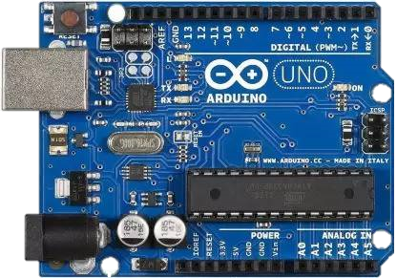
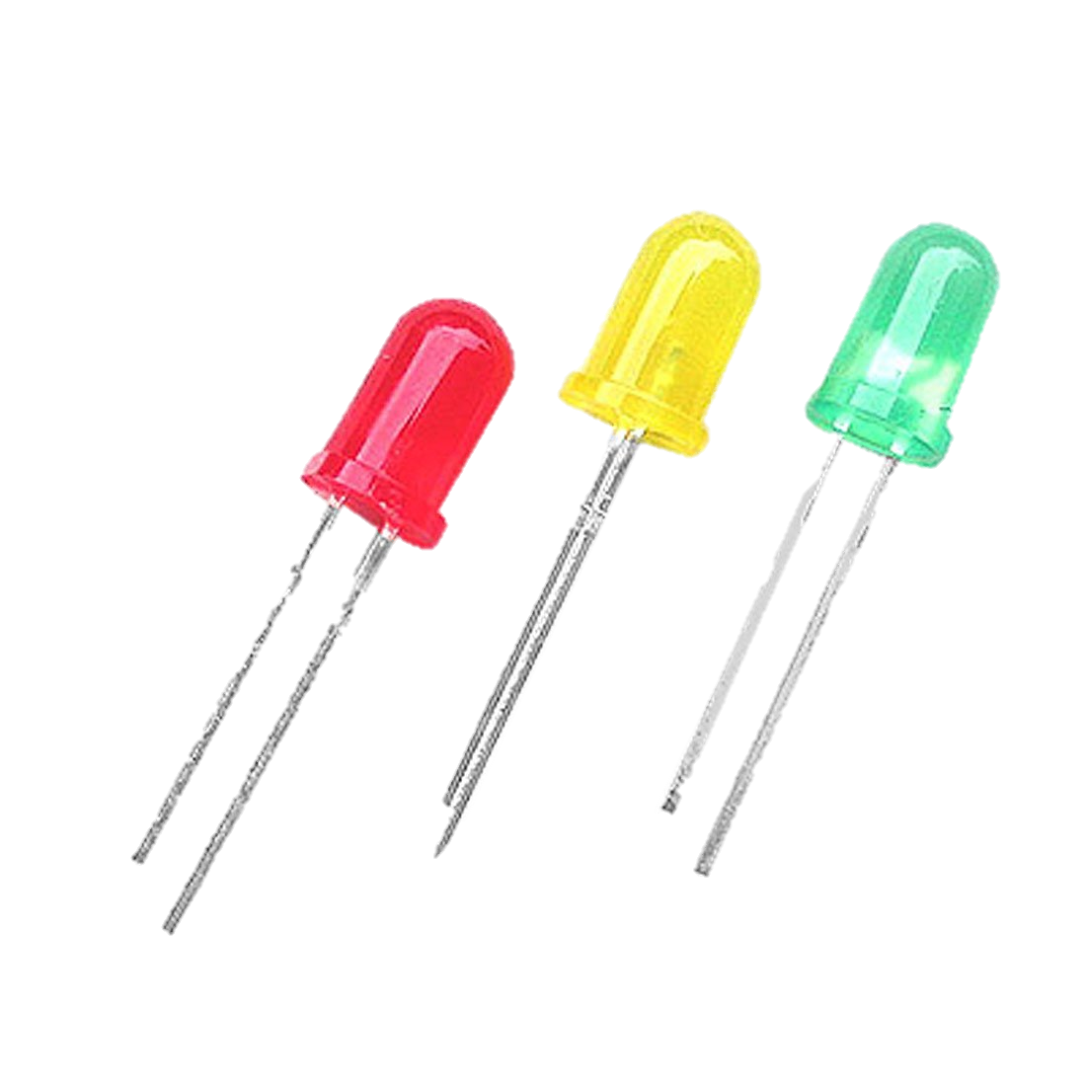
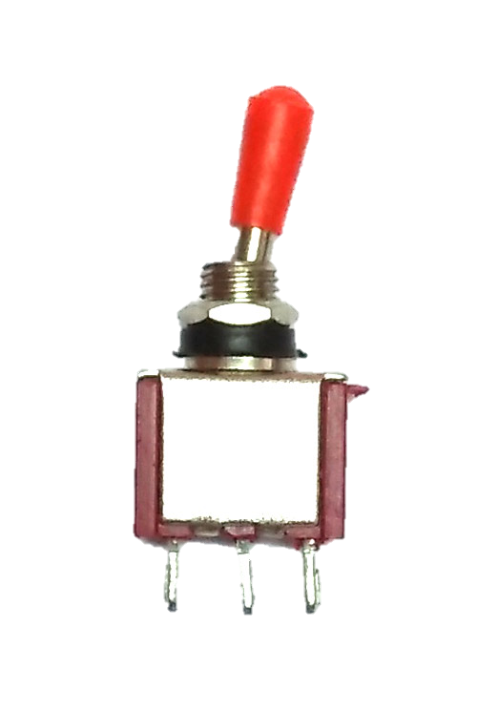
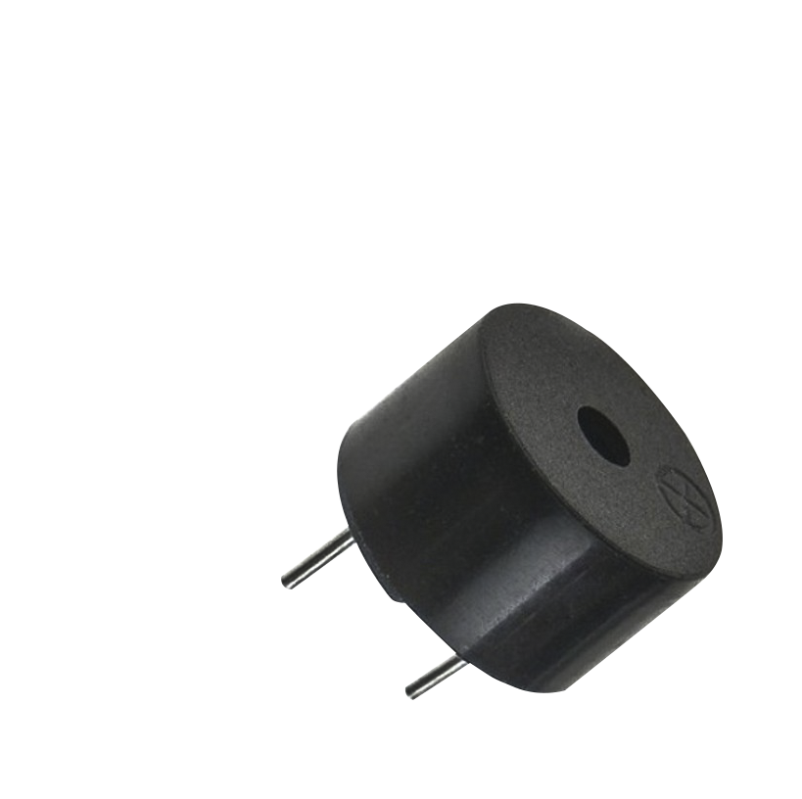
COMPONENTS REQUIRED
Arduino UNO (controller)
LEDs (RED, YELLOW, GREEN) for signal lights
Toggle Switch SPDT (Single pole Dual thro) as user Inputs
Buzzer
Arduino UNO LEDs Switch Buzzer

Slide 4
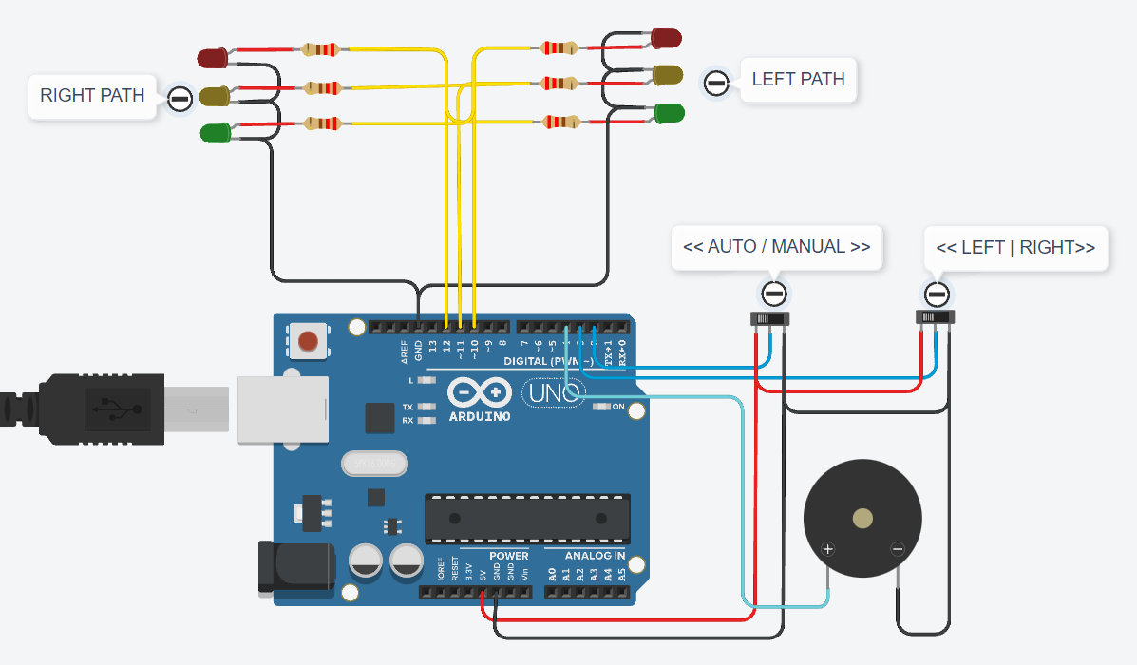

Slide 5
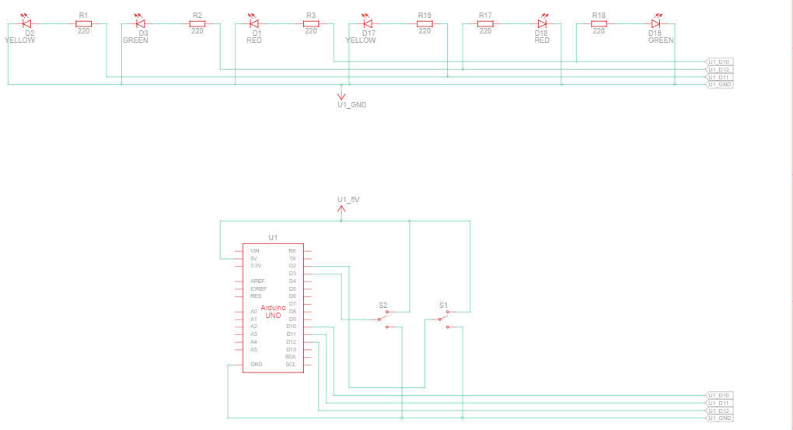

Slide 6
Program Algorithm
Initialize serial, input and output
Beep Buzzer while every transition
While MANUAL mode is selected i.e. Pin 2 is LOW
Red at right and Green at left if LEFT is selected
Red at left and Green at right if RIGHT is selected
While AUTO mode is selected i.e. Pin 2 is HIGH
Yellow for few seconds
Red at right and Green at left for set Time
Yellow for few seconds
Green at right and Red at left for set Tim

Slide 7
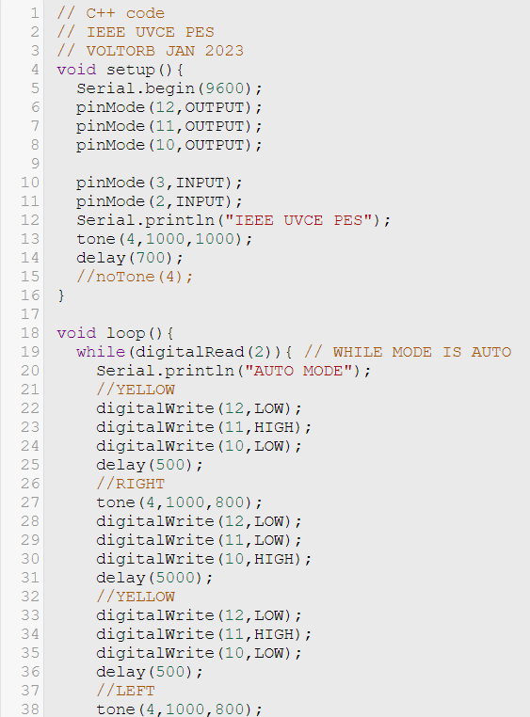
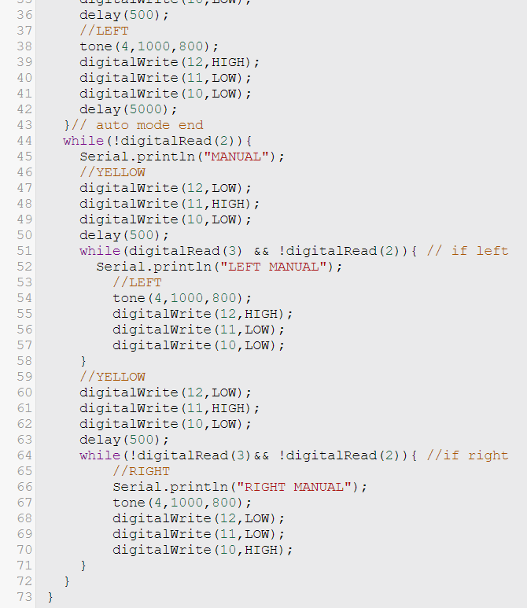
Program in GitHub repository

Slide 8
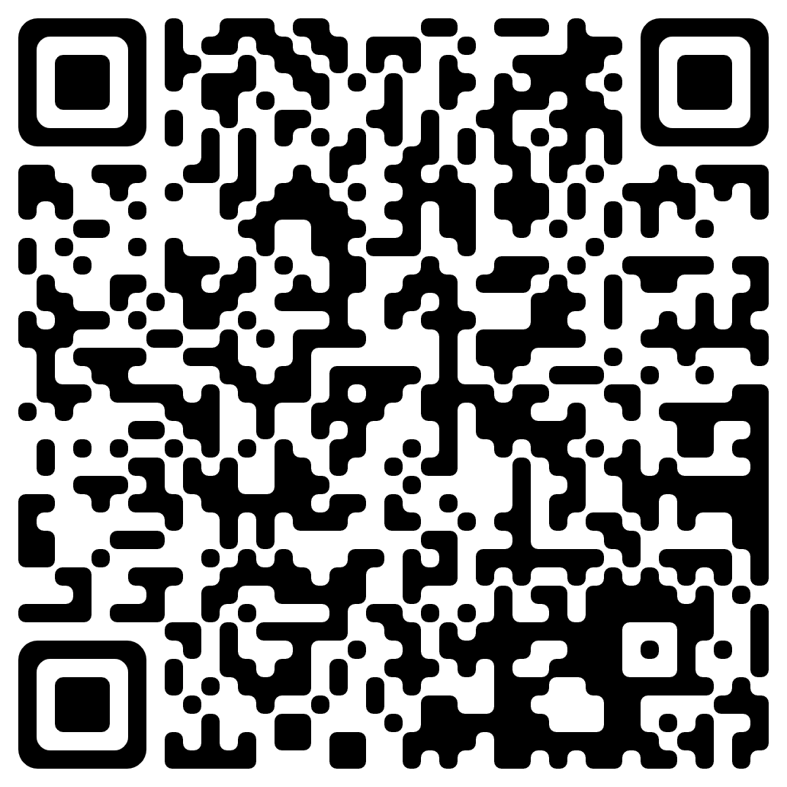
THANK YOU
IEEE UVCE PES
TinkerCad simulation Link

